Slide 1
Org Structure Analytics
Responsible for
- Core Development (IT Delivery)
- Data Model changes
Analytics
Elaine Robinson
Data Science & Visualization
Pat Joyce
Data Engineering
Rafael Borghi
SAP Business Warehouse
Karen O’Sullivan
Hub
ESB Networks
Mick Finn & Team
Spoke
Customer Solutions
E&MP
Generation & Trading
ES & SIT
Valerie Lynch & Mary Walsh
Niamh Symth & Team
Jennifer Jennings
Daragh Noctor & Team
Responsible for
Business Spoc/Analyst
Deliver certain reports as per need
Facilitate integration with Hub
Notes:
SIT - Strategy, Innovation and Transformation

Slide 2
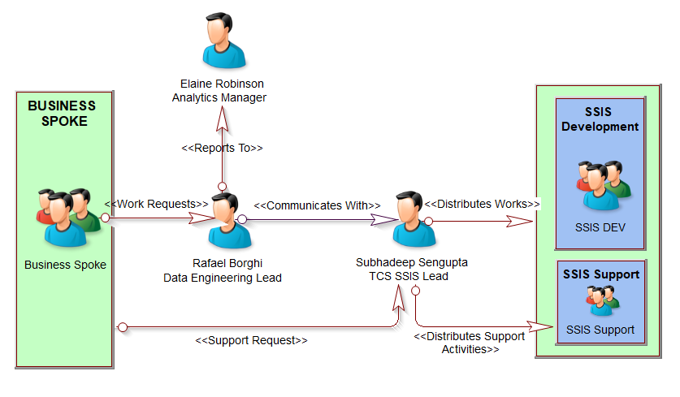
SSIS Business Communication Structure

Slide 3
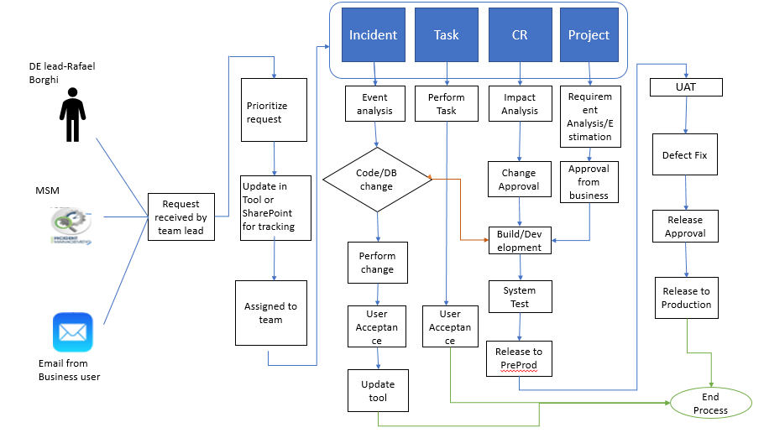
SSIS Process Flow

